Slide 1

Little Miami High School
Freshman Orientation
Class of 2026

Slide 2
Introductions
Administrators:
Dr. Cathy Trevathan, Principal
Dr. Kevin Harleman, Assistant Principal
Mr. Chad Huelsman, Assistant Principal
Academic / Career Counselors: Student Support Counselors:
Ms. Ashley Brown (A-D) Ms. Meredith Reuscher
Mrs. Maggie Ochsner (E-K) Dr. Mary Kamphaus
Mr. Todd Barnhart (L-R) Beech Acres Support Services
Ms. Brandy Phillips (S-Z)

Slide 3

Ninth Grade: An Important Year
Honors Recommendations
LMHS Student Expectations
Extra Time, Extra Help (ETEH)
Bell Schedule

Slide 4
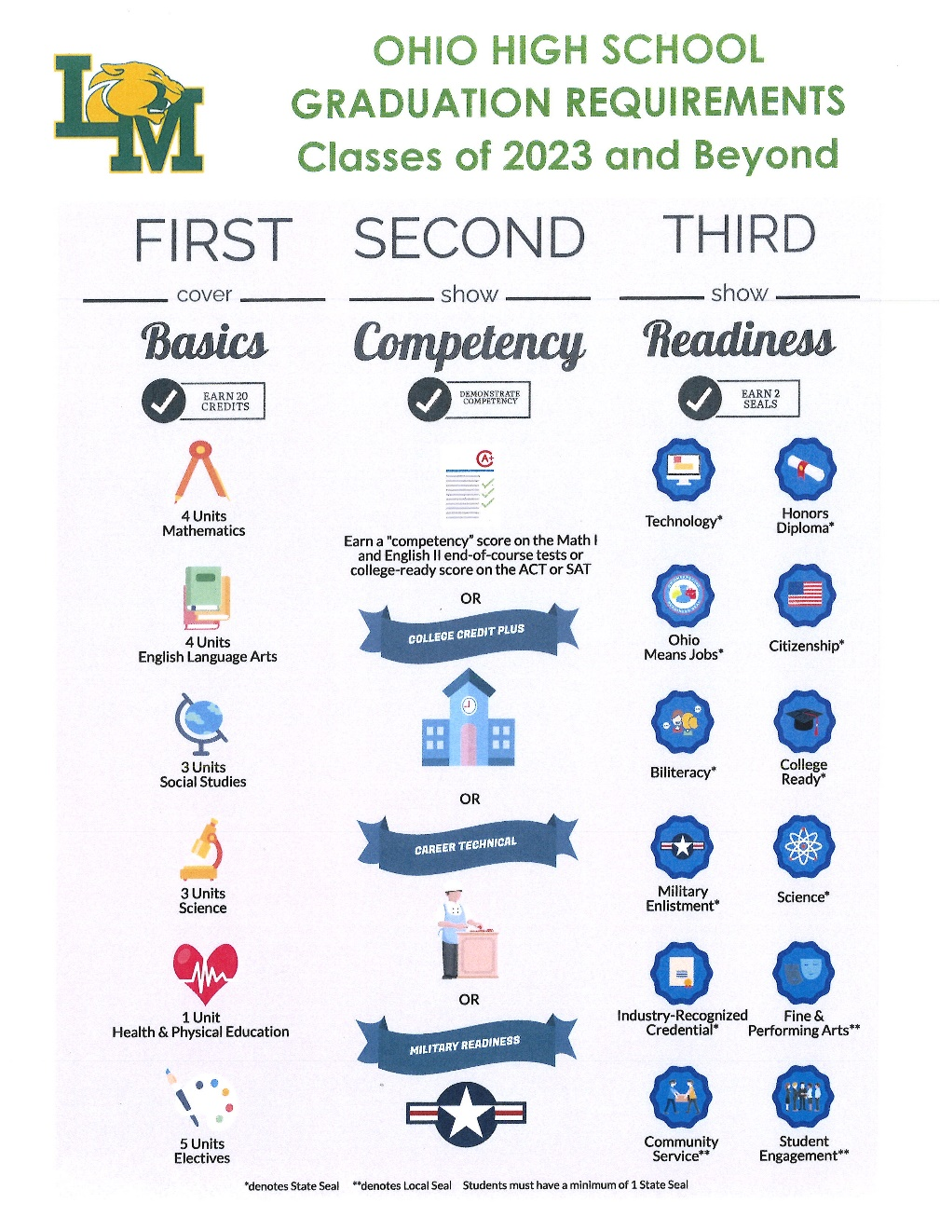
New Requirements for Graduation

Slide 5
Credits Required for Graduation
English: 4 credits
Math: 4 credits (Algebra 2)
Science: 3 credits (Physical Science, Biology, Advanced)
Social Studies: 3 credits (World History, American History, Economics, American Government)
Health: ½ credit
Physical Education: ½ credit
Fine Arts: 1 credit
Electives: 4 credits
*Financial Literacy may be added as a requirement for graduation, which will change the total credits needed to 20.5
TOTAL = 20 credits

Slide 6
Athletic Eligibility
Must pass 5 one credit classes per year
  PE CLASSES DO NOT COUNT
Eligibility checks done weekly
Each sport will cost $225 during the 2022-23 school year
(For multiple sports and multiple family athletes contact Mr. Louis as there is a cap price for families)
For Athletic Eligibility questions, please contact:
Mr. Matt Louis, Athletic Director
mlouis@lmsdoh.org

Slide 7
Honors Diploma Requirements
Must earn all but ONE of the following:
English: 4 credits
Math: 4 credits (Algebra I, Geometry, Algebra 2)
Science: 4 credits (Physical Science, Biology, Two Advanced Sciences)
Social Studies: 4 credits
World Language: 3 credits (2-2)
Fine Arts: 1 credit
Grade Point Average: 3.5+ (unweighted)
ACT / SAT: 27+ / 1280+

Slide 8
Considerations Before Taking an Advanced Course
How much of your life do you want to be dedicated to academic work? In other words, how much “school” are you comfortable doing outside school?
What does your extra-curricular schedule look like?
What does your overall course schedule look like? Are you taking a study hall? Will you make proper use of ETEH?
What is your reading level and content knowledge?
Are you an independent learner? Can you annotate and take your own notes?
What is your work ethic and self-discipline like? Can you remain organized?
Are you resourceful? Do you know how to seek help when needed?
Are you comfortable working in a timed environment?
How do you respond to constructive feedback? How do you handle imperfection?
Can you still find value and enjoyment out your experience even if you don’t receive your desired grade?

Slide 9
College Prep vs. Honors vs. Advanced Placement
The decision to take an advanced class rests on a number of variables and is unique to each student
The best thing to do is consult with your child’s current teachers and/or prospective teachers

Slide 10
Key Differences Between
College Prep and Advanced Courses
Volume of work
Pacing of instruction
Rigor of testing, higher expectations on writing
More advanced ancillary reading and/or textbook
Advanced levels of critical thinking
Resourcefulness, self-discovery, and independent problem-solving are more necessary in advanced classes
Being academically-ready vs. emotionally-ready

Slide 11
Weighted Classes
Honors, Advanced Placement (AP)
  .05 added to GPA for passing grades per semester
College Credit Plus (CC+) courses
  .05 or .10 added to GPA for passing grades per semester that is equivalent to weighted courses at the high school.
  Classes 2 credit hours or less = .05
  Classes 3 credit hours or more = .10

Slide 12
College Recommended Courses
4 years of English
4 years of Math
4 years of Science
3 years of Social Studies
2-3 years of World Language
1 year of Fine Arts

Slide 13

Required Courses for 9th grade
English 9 or Honors English 9
Math: Algebra 1, Geometry, Algebra 2, Honors Algebra 1, Honors Geometry, or Honors Algebra 2
Science: Physical Science or Honors Biology
Social Studies: World History, Honors World History, AP World History
Physical Education
Study Hall

Slide 14
Physical Education Requirement
Physical Education (full year)
Summer School PE:
See Next Slide
P.E. Option
  MUST complete two full seasons of a sport
  CANNOT combine P.E. classes and a sport
  MUST be OHSAA sanctioned and offered at LMHS
Must complete 2 full seasons of Marching Band
Air Force JROTC – 2 years
Kinesiology and Fitness DOES NOT COUNT

Slide 15
SUMMER PE
Summer School Physical Education
Grade Level: 9-12
Course Length: 12 days in the summer 8:00 AM to 1:00 PM Credit: 0.25
Prerequisite: None
Approximate cost: $105.00 per session
Two sessions are each 12 days running from 8:00 AM -1:00 PM, a session starting June 7 and another session beginning on June 23.
There is an attendance requirement to pass.
Students can enroll in both sessions to meet the physical education graduation requirement that meet all state standards.
Session dates for the summer of 2022: Session 1 06/07-06/22 (virtual) Session 2 06/23-07/08 (virtual)

Slide 16
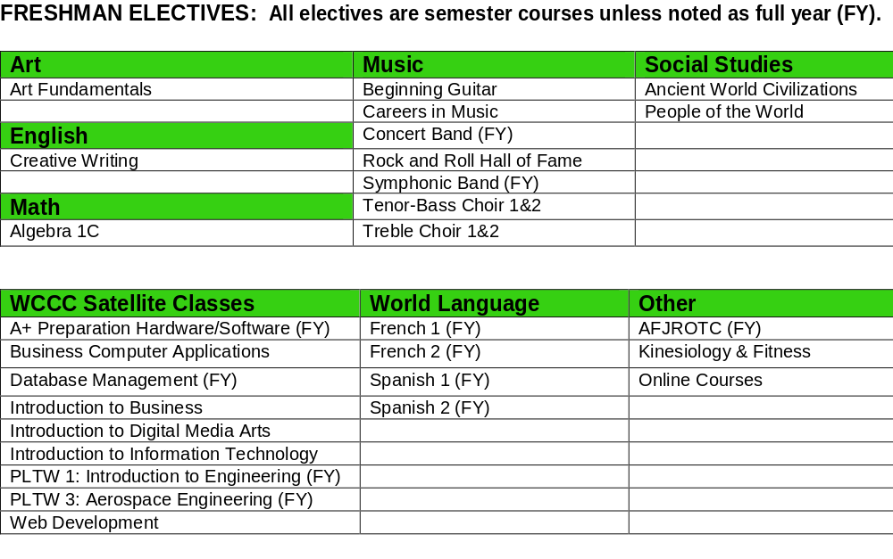
Elective Options

Slide 17
Online Elective Courses
Course descriptions are listed in the Little Miami course guide
Course fee is pending, but will be between $280-$560 per semester class
Course taken during school day

Slide 18
Scheduling Process: In-Person Students
All registration forms are due Friday, February 25, 2022 to LMMS social studies teachers.
Counselors will meet with students individually on March 3 and March 4 at LMMS.
During these meetings, students will receive Override forms, Online elective class forms, and Summer PE forms.
On March 7 all Override and Online elective class forms are due.

Slide 19
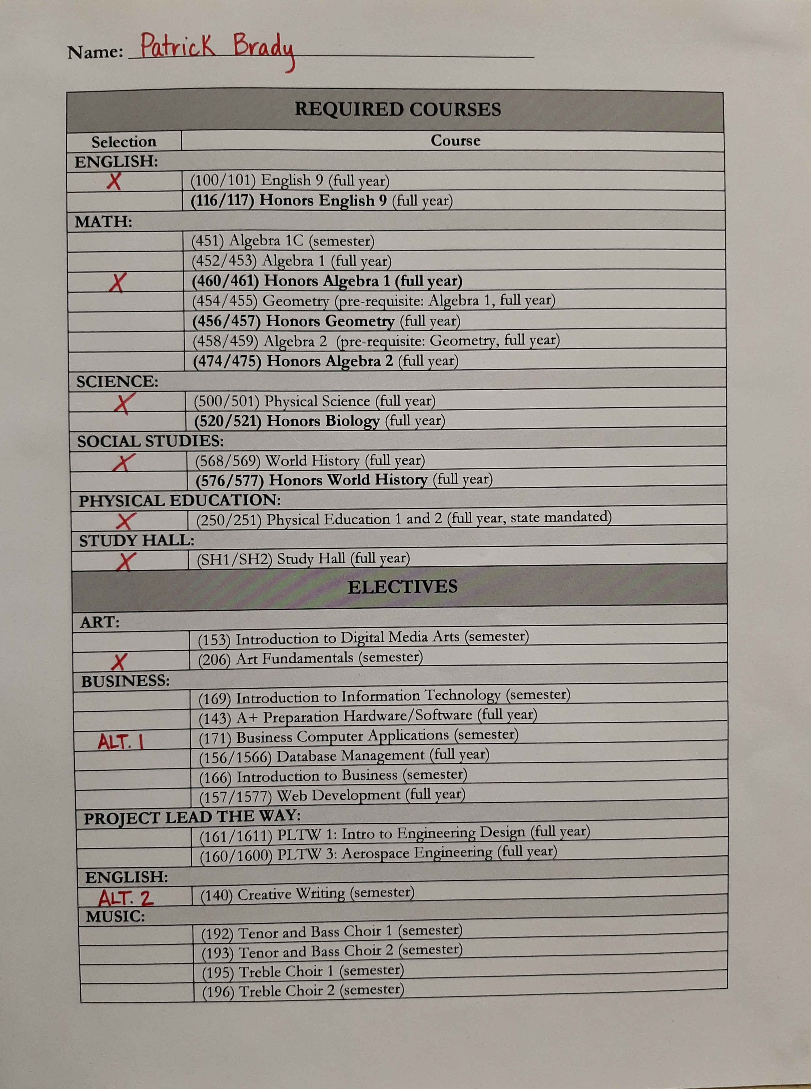
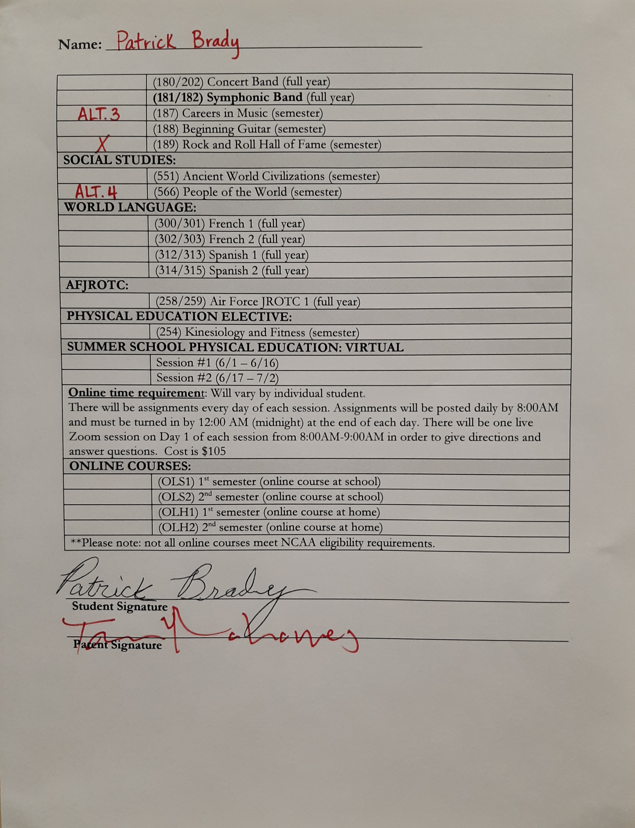
Example Registration Form

Slide 20
Schedule Changes
Student will have five days in the beginning of each semester to change semester-long elective courses.
Class selections will be final at the conclusion of the spring semester, prior to the start of the new school year. If a yearlong course is dropped at any time, the student will receive a Withdrawal Fail on the transcript.

Slide 21
Counselor Contact Information
Ms. Ashley Brown (A-D)
abrown@lmsdoh.org
Mrs. Maggie Ochsner (E-K)
mochsner@lmsdoh.org
Mr. Todd Barnhart (L-R)
tbarnhart@lmsdoh.org
Ms. Brandy Phillips (S-Z)
bphillips@lmsdoh.org

